Slide 1


Hotel management data base
DataBase
Welcome to

Slide 2

Made by :
Supervised by :
DataBase
Ahmed El-Gendy
Ahmed Abas
Hassan shehata
Rami Rashad
Dr.Walaa Saber
Eng. Aya Abd-El-Hady

Slide 3
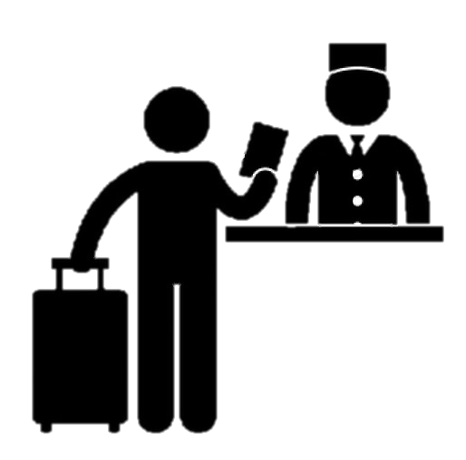
- What is database ?
DataBase
- how it can be usefull to
hotel management?

Slide 4






How It can be usefull to Hotel Management?
DataBase
Hotel Management

Slide 5
E R MODEL
DataBase

Slide 6
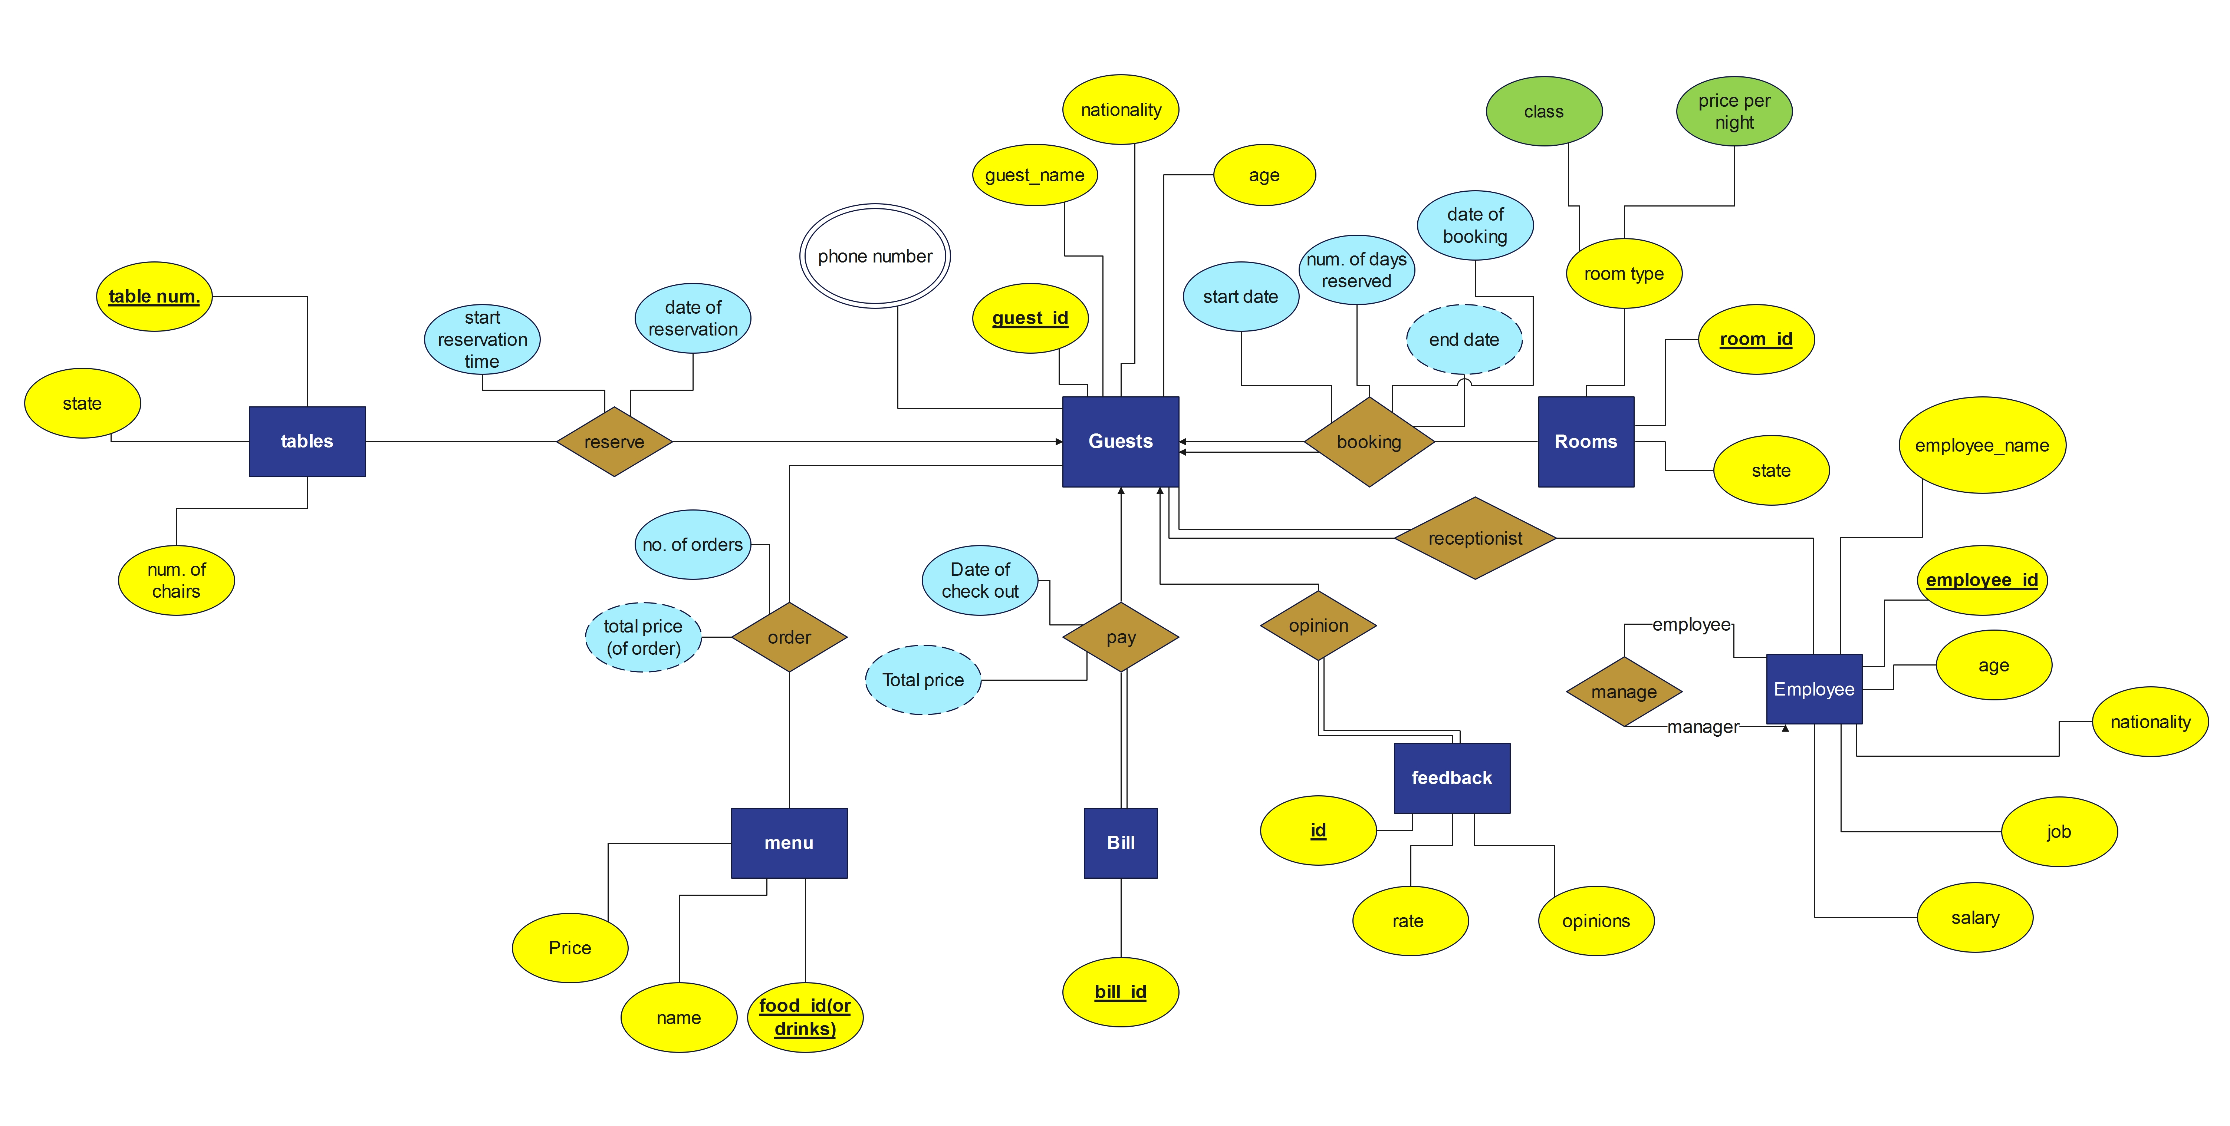
E R MODEL
DataBase

Slide 7
Relational model
DataBase

Slide 8
Relational model
DataBase
Guest( guest_id , guest name , age , nationality).
Guest_num ( guest_id , phone number).
Rooms( room_id ,state , class , price per night , guest_id , start date , num. of days reserved , date of booking).
Bill(bill_id, guest_id , date of check out).
Feedback(id , opinions , rate , guest_id ).
Employee(employee_id , employee_name , age , nationality , job , salary, manger_id ).
Menu(food_id(or drink) , Price , name).

Slide 9
Relational model
DataBase
Order(guest_id , food id, num of order).
tables(table num , state, num of chairs , guest_id , date of reservation, start reservation time).
Receptionist (guest_id , employee_id)
Notes:
End date[derived] in Rooms.
Total price [derived ] in Bill.
total price [derived ] in Order.

Slide 10
Sql coding
DataBase

Slide 11
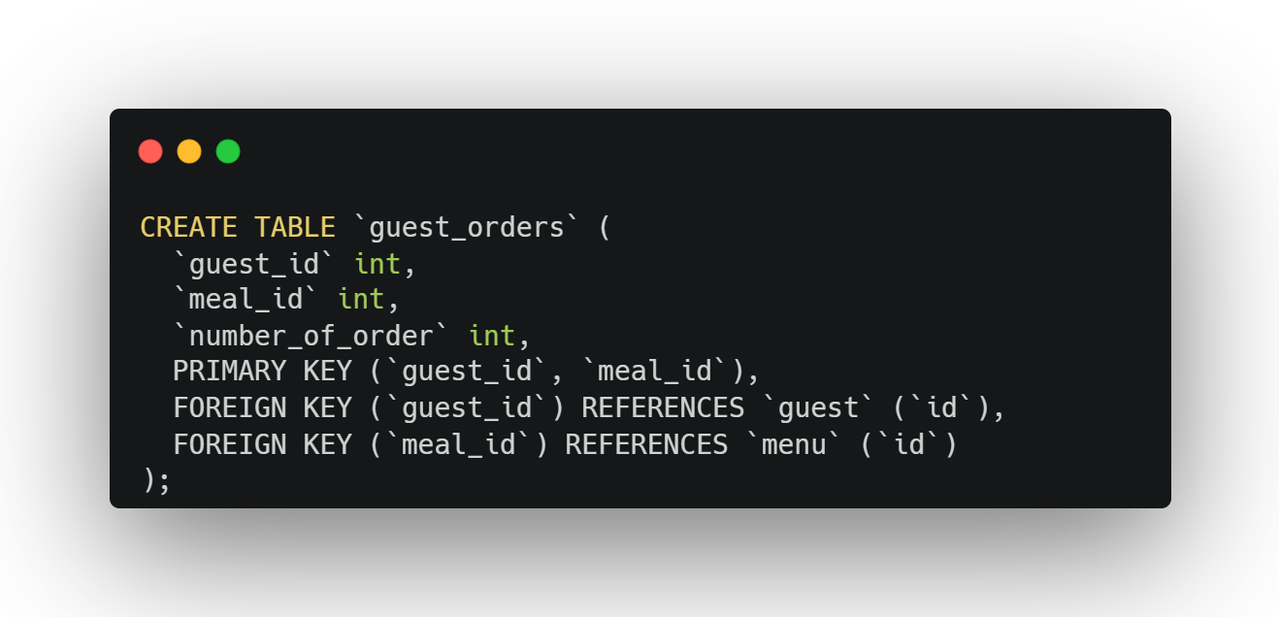
Create the tables
DataBase

Slide 12
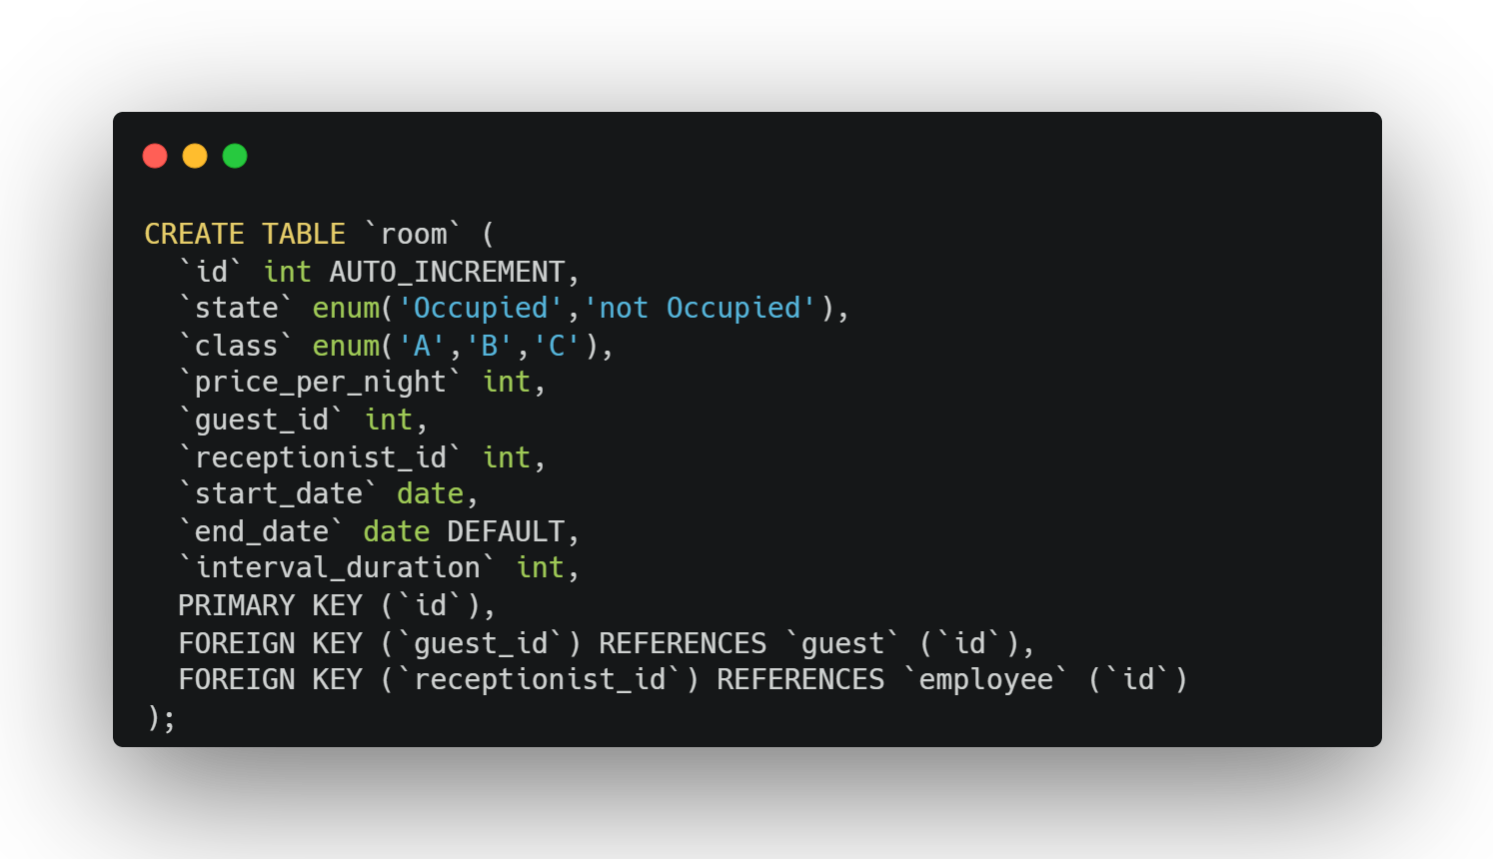
Create the tables
DataBase

Slide 13
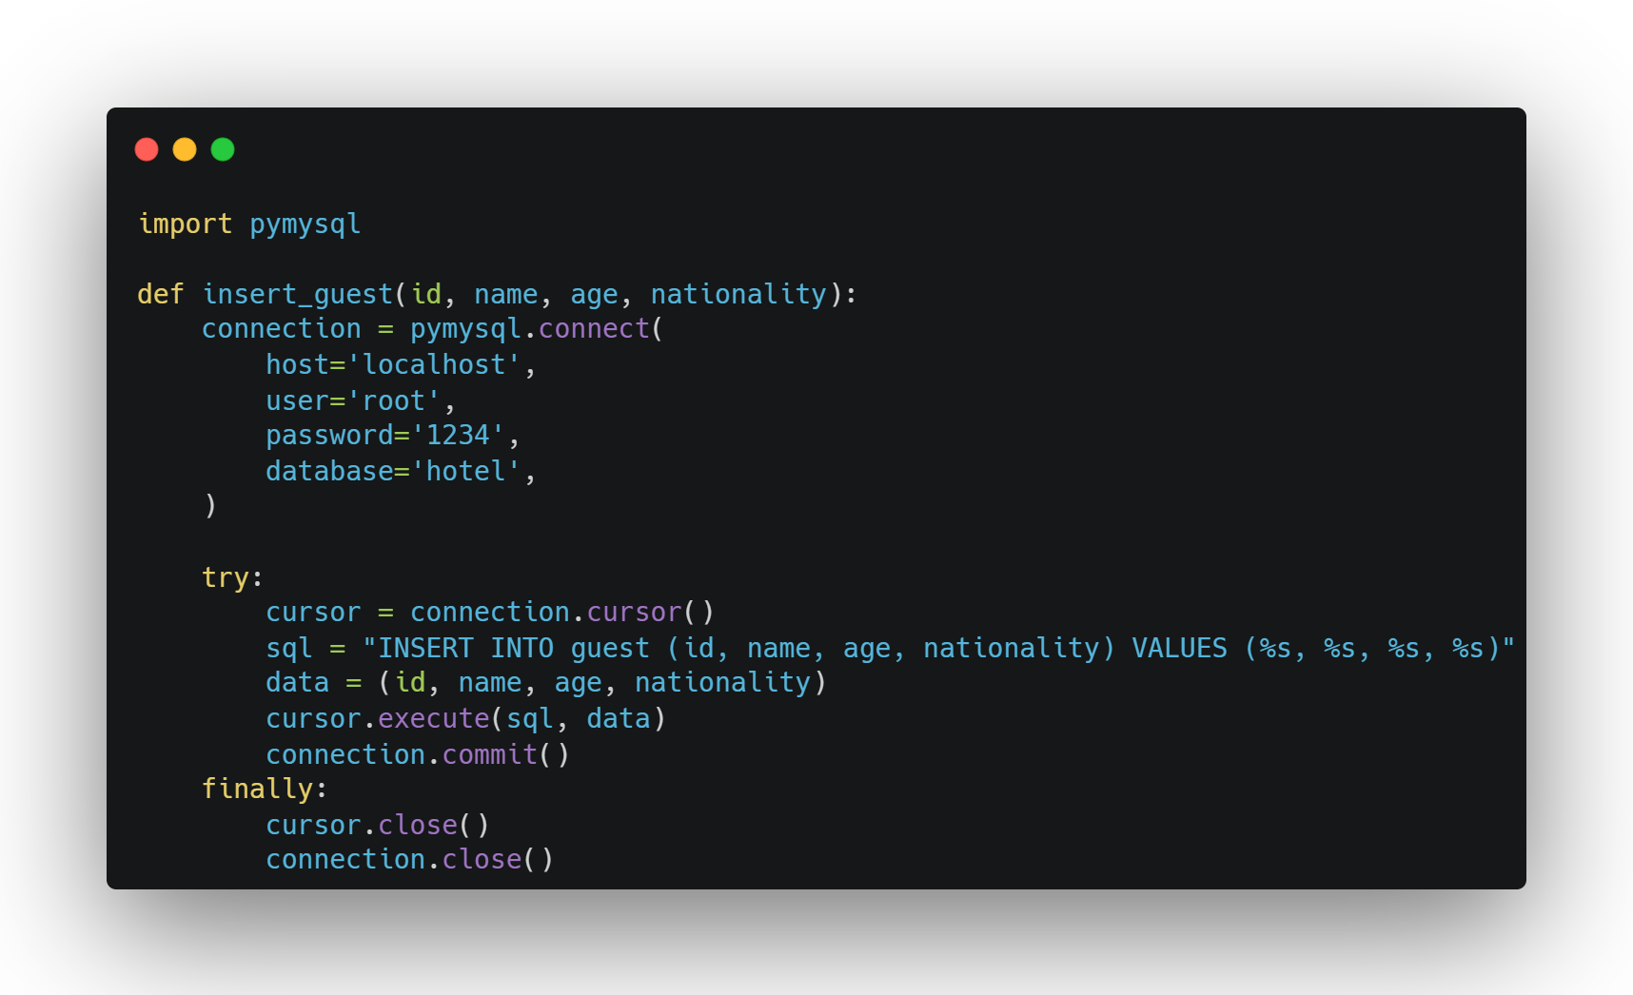
Connection to database
DataBase
Here’s what we made to connect our Database to Python code:

Slide 14
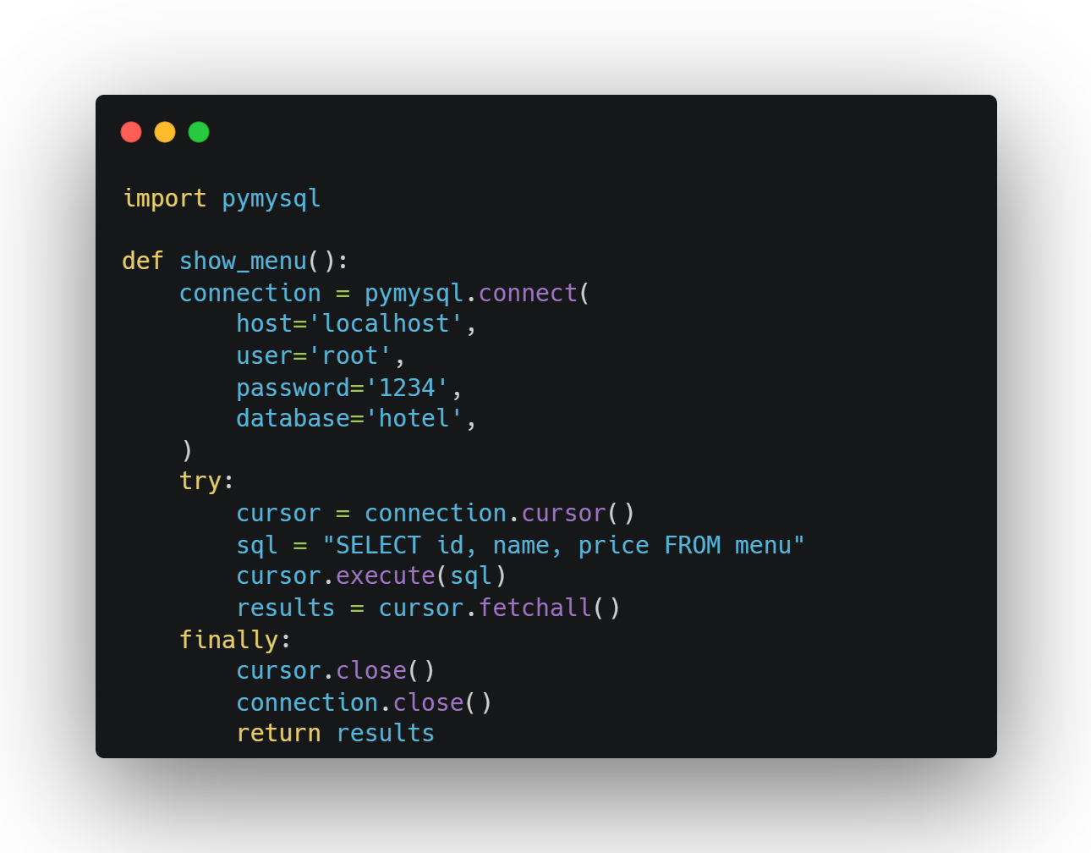
Connection to database
DataBase
Here’s what we made to connect our Database to Python code:

Slide 15
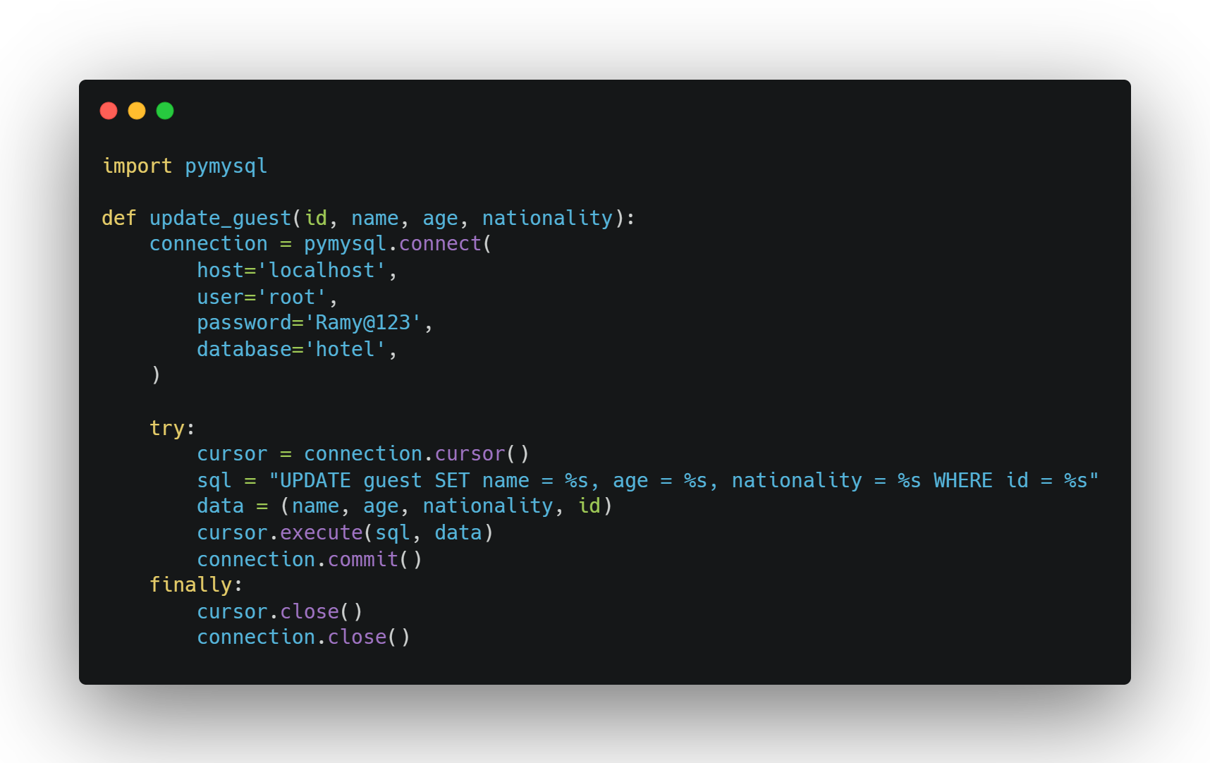
Connection to database
DataBase
Here’s what we made to connect our Database to Python code:

Slide 16
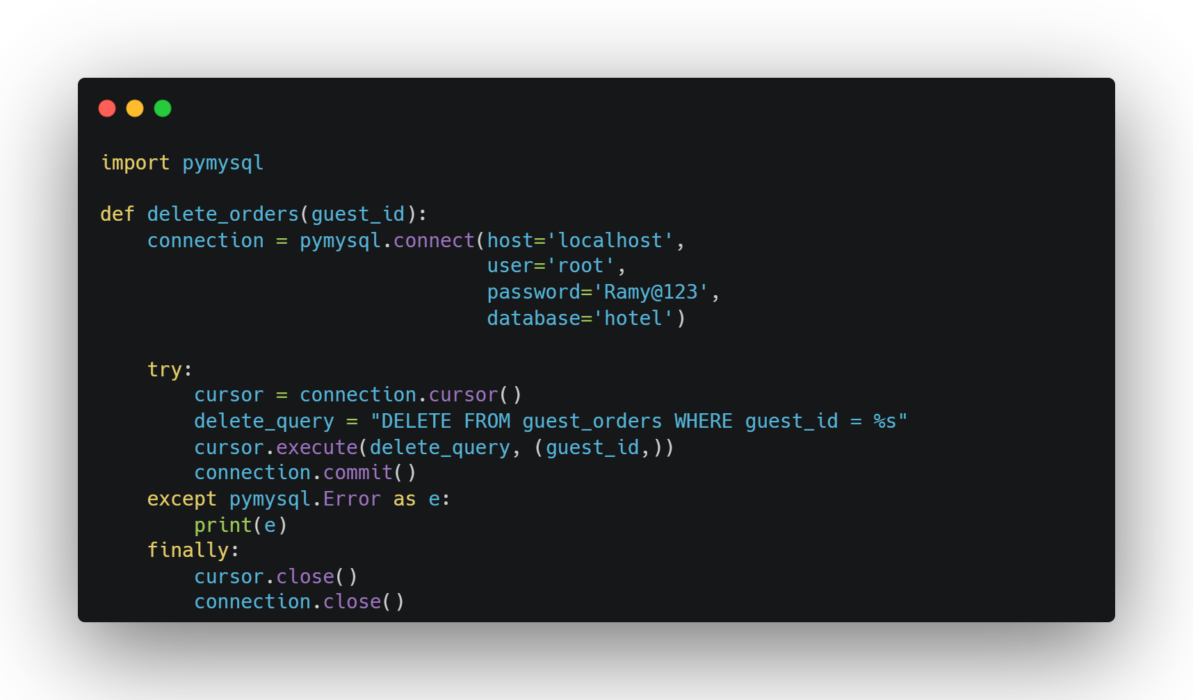
Connection to database
DataBase
Here’s what we made to connect our Database to Python code:

Slide 17
